Slide 1

Variational Bayesian inference for system identification
Wouter M. Kouw Nonlinear System Identification Workshop 2023
Code and videos @https://github.com/wmkouw/NSIW2023-keynote

Slide 2

Onderzoeksraad voor veiligheid: https://youtu.be/LJevke4_i5Y
Notes:
- Failure of a control system. Prediction error between planned future state (based on policy) and actual future state.

Slide 3
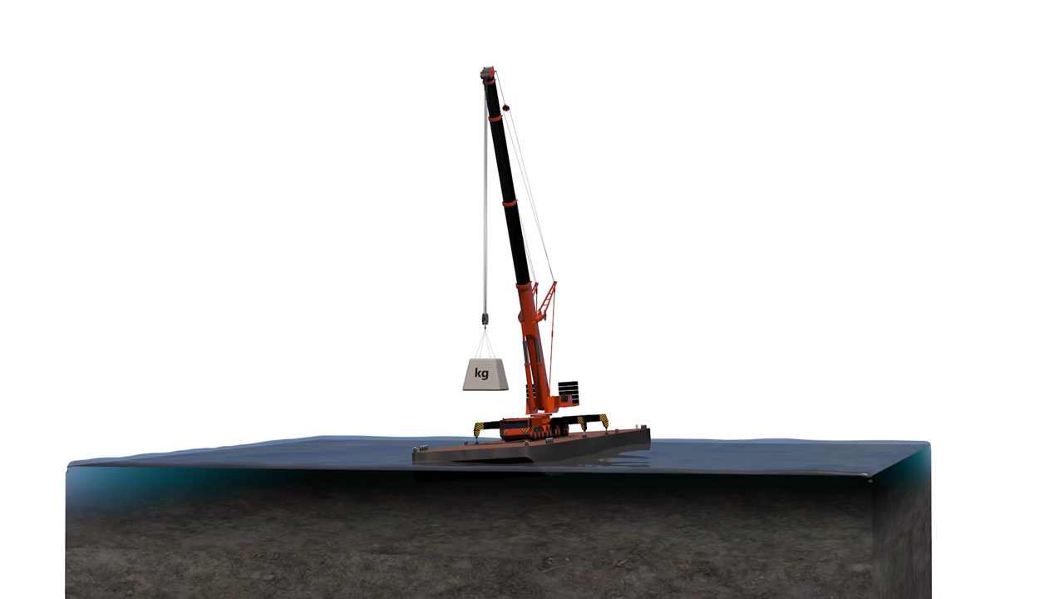

Uncertainty
What value do parameters in my model have?
How many parameters affect my system?
Do my parameters change over time?
Is my system affected by external disturbances?
Which model should I select for this system?
What should I measure to identify my system?
Onderzoeksraad voor veiligheid: https://youtu.be/LJevke4_i5Y
Notes:
Pause gif after 1 sec (before length of cable and platform width change).

Slide 4
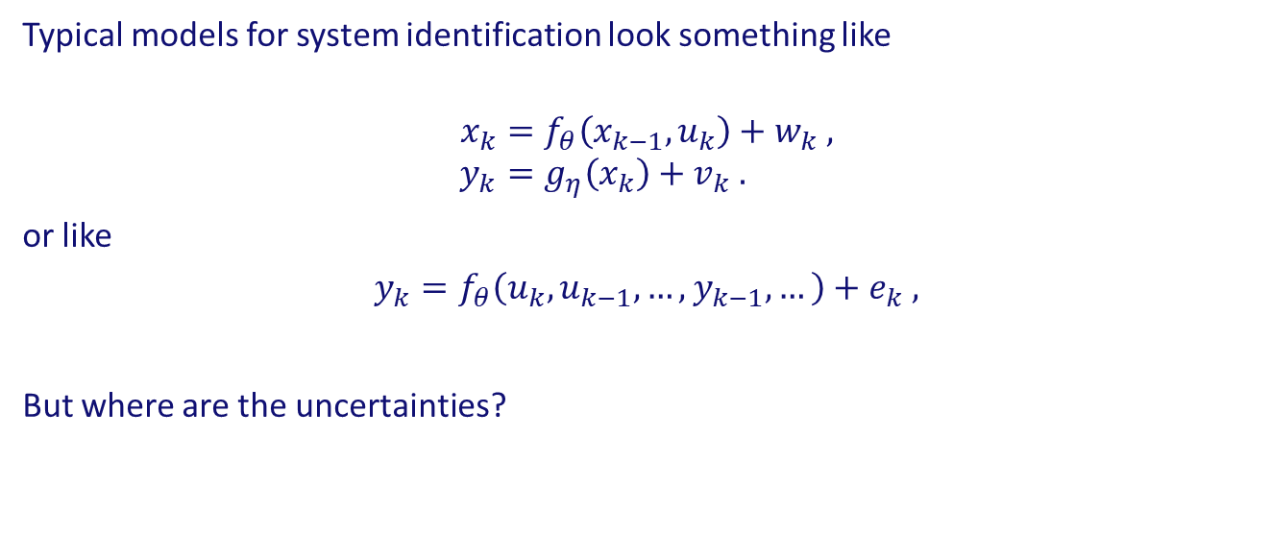
Modelling
Typical models for system identification look something like
$$x_{k}=f_{θ}\left(x_{k−1},u_{k}\right)+w_{k} , \\ y_{k}=g_{η}\left(x_{k}\right)+v_{k} .$$
or like
$$y_{k}=f_{θ}\left(u_{k},u_{k−1},…, y_{k−1},…\right)+e_{k} ,$$
But where are the uncertainties?
Notes:
Noise is not the only source of uncertainty.
Uncertainties in parameters, in data, in assumptions, in model design?

Slide 5
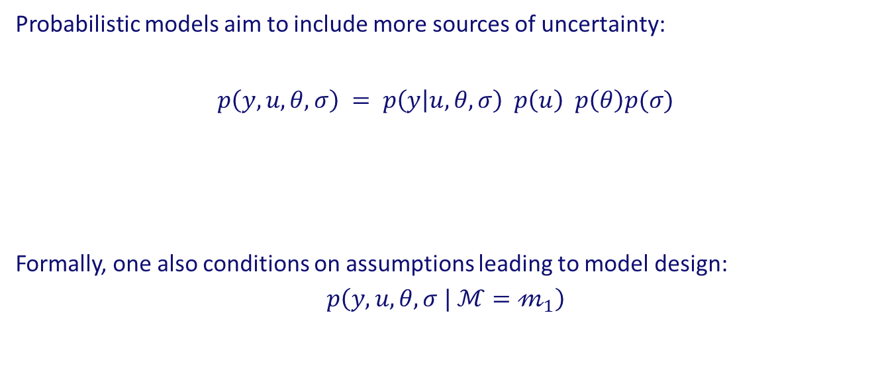
Probabilistic modelling
Probabilistic models aim to include more sources of uncertainty:
$$p\left(y,u,θ,σ\right) = p\left(y | u,θ,σ\right) p\left(u\right) p\left(θ\right)p(σ)$$
Formally, one also conditions on assumptions leading to model design:
$$p\left(y,u,θ,σ | ℳ=𝓂_{1}\right)$$
generative model
observation model
input prior
parameter priors
Notes:
- It’s called a “generative” model, because one can generate new observations with it.
- If one only has 1 input data set and no knowledge of how it was generated, then the model is conditioned on some u_k = \hat{u}_k.
- Model conditioning is ignored (for brevity reasons) when only 1 model is considered. It is restored when two models are compared.

Slide 6
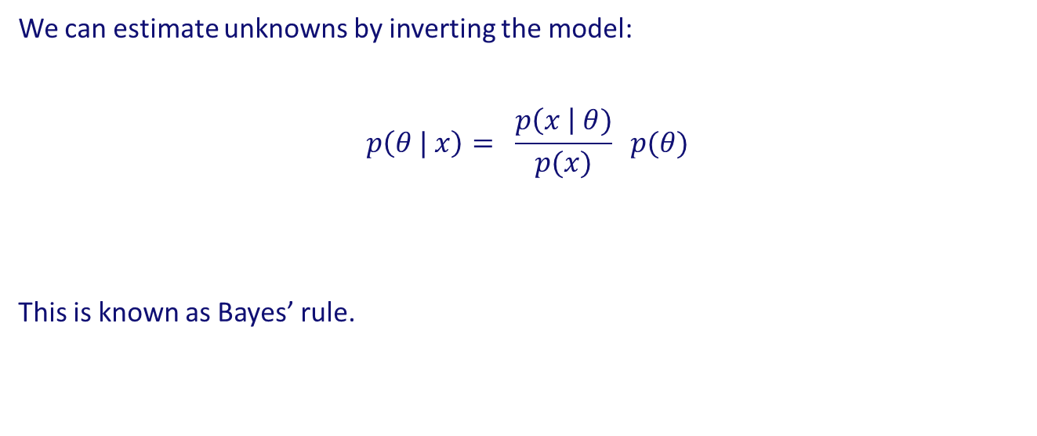
Inference
We can estimate unknowns by inverting the model:
$$p\left(θ | x\right)= \frac{p\left(x \right| θ)}{p(x)} p(θ)$$
This is known as Bayes’ rule.
likelihood
posterior distribution
evidence
prior distribution
Notes:
- Often referred to as “belief updating” because priors become posteriors.

Slide 7
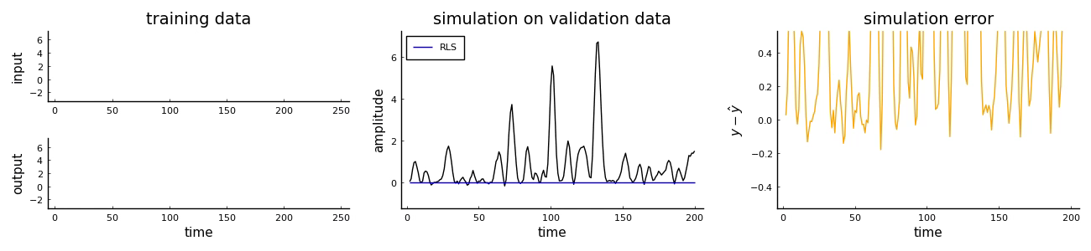
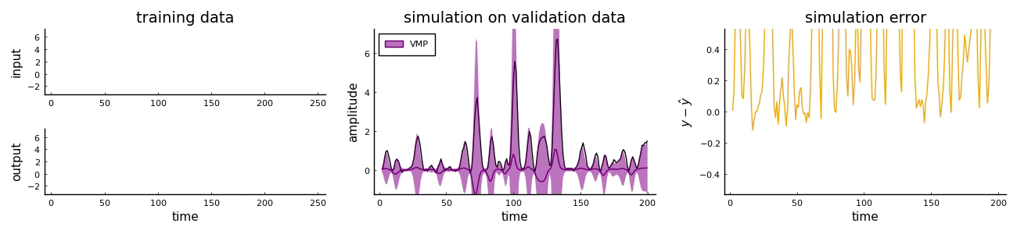
Is all that extra work useful?
Yes
Kouw, Podusenko, Koudahl & Schoukens (2022). Variational message passing for online polynomial NARMAX identification.
Notes:
The improvement is caused by 1) more information is given to the model (ie priors) and 2) a posterior predictive distribution is more “naturally regularized” than a point-estimator-based simulation.
The model shown here actually uses variational Bayes, to be explained later.

Slide 8
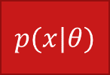
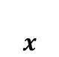
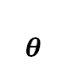
Factor graphs
Probabilistic model equations quickly become complex and hard to read.
It helps to adopt a visual language: factor graphs.
$$θ$$
Edges represent variables in the model.
Nodes represent relationships between variables.
$$p(x|θ)$$
$$x$$
Notes:
- “Relationships” refer to the factors of the probabilistic model, which may be deterministic or stochastic.

Slide 9
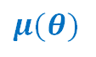
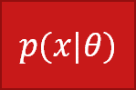
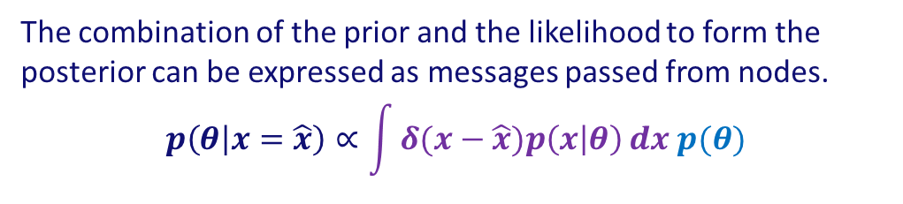
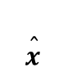
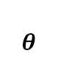
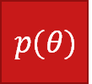
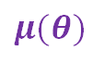
Message passing
The following is a complete factor graph:
$$p(θ)$$
Terminal nodes are priors.
$$μ(θ)$$
The combination of the prior and the likelihood to form the posterior can be expressed as messages passed from nodes.
$$p\left(θ | x=\hat{x}\right)∝\int{δ(x−\hat{x})p\left(x | θ\right)}dx p(θ)$$
$$θ$$
$$μ(θ)$$
$$p(x|θ)$$
$$\hat{x}$$
Black nodes represent observed data.
Notes:
Messages are probability distributions.
Data are constraints.
The multiplication of pdf’s produces another pdf.

Slide 10
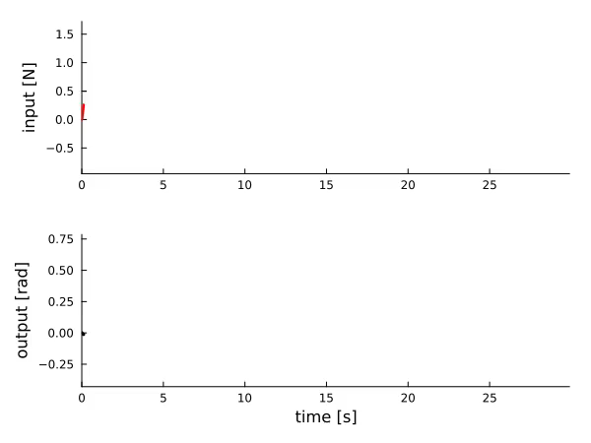
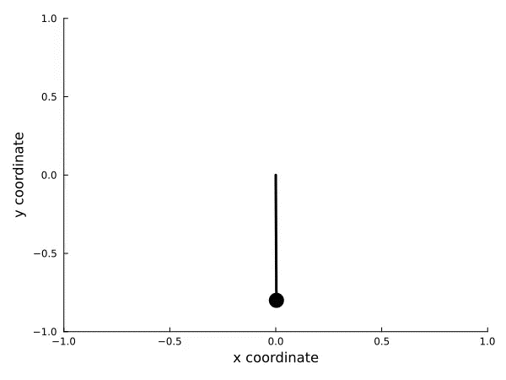
Demonstration system
Notes:
- Pendulum is a simple form of nonlinear dynamics.

Slide 11
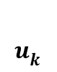
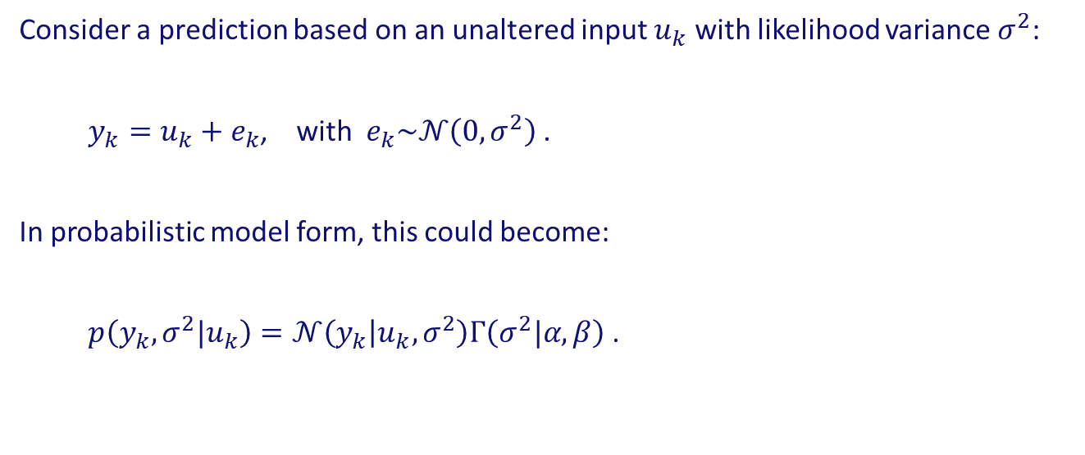
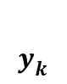
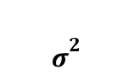


Model 1
Consider a prediction based on an unaltered input $u_{k}$ with likelihood variance $σ^{2}$:
$y_{k}=u_{k}+e_{k}$, with $e_{k}\sim 𝒩\left(0,σ^{2}\right)$ .
In probabilistic model form, this could become:
$p\left(y_{k},σ^{2}|u_{k}\right)=𝒩\left(y_{k} | u_{k},σ^{2}\right)Γ\left(σ^{2}|α,β\right)$ .
$$Γ$$
$$σ^{2}$$
$$𝒩$$
$$u_{k}$$
$$y_{k}$$
Notes:
- Classical model: y_k = u_k + e_k
- Other parametric distribution choices are possible, but here I choose one for the sake of the running the demo.

Slide 12
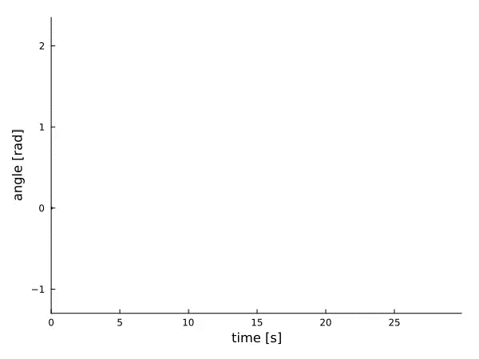
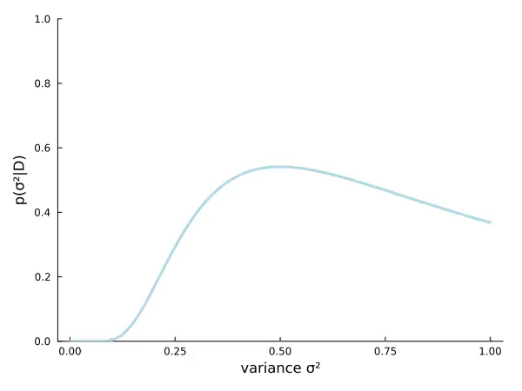
Model 1
Notes:
As data streams in, our belief over sigma^2 starts to concentrate on some value.

Slide 13
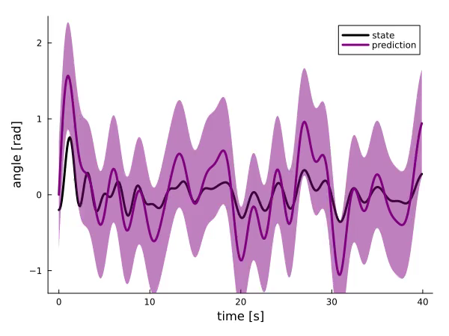
Model 1
Notes:
- Right figure is simulation on a validation data set (obviously bad predictions), whose uncertainty is based on the variance estimated in the training set.

Slide 14
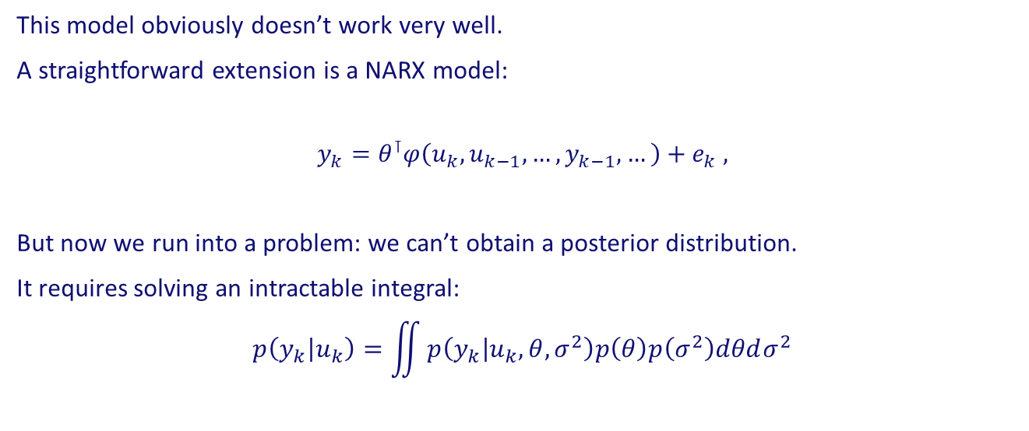
Model 1
This model obviously doesn’t work very well.
A straightforward extension is a NARX model:
$$y_{k}=θ^{⊺}φ\left(u_{k},u_{k−1},…, y_{k−1},…\right)+e_{k} ,$$
But now we run into a problem: we can’t obtain a posterior distribution.
It requires solving an intractable integral:
$$p\left(y_{k} | u_{k}\right)=\iint{p\left(y_{k} | u_{k},θ,σ^{2}\right)p\left(θ\right)p\left(σ^{2}\right)dθdσ^{2}}$$
Notes:
Integral is intractable because
1) if you start integration with sigma then you get a student’s t times a Gaussian, or
2) if you start with theta, then you end up with an expectation over a difficult log term (to be precise: log[\phi \Sigma_\theta \phi’ + \sigma^2]).

Slide 15
Exact inference
Limited to conjugate priors:
Normal-Wishart
Geometric
Weibull
Wishart
Negative Binomial
Normal
Normal-Gamma
Bernoulli
Beta
Gamma
Binomial
Exponential
Dirichlet
Pareto
Poisson
Multinomial
Categorical
Uniform
Notes:
Only certain combinations of parametric distributions lead to exact Bayesian inference.
This looks like a lot, but actually the class of models you can build with these is fairly limited.
Not shown are scaled inverse chi-squared, hypergeometric, Lévy, beta-Bernoulli compound, and the inverse-(gamma/wishart),

Slide 16
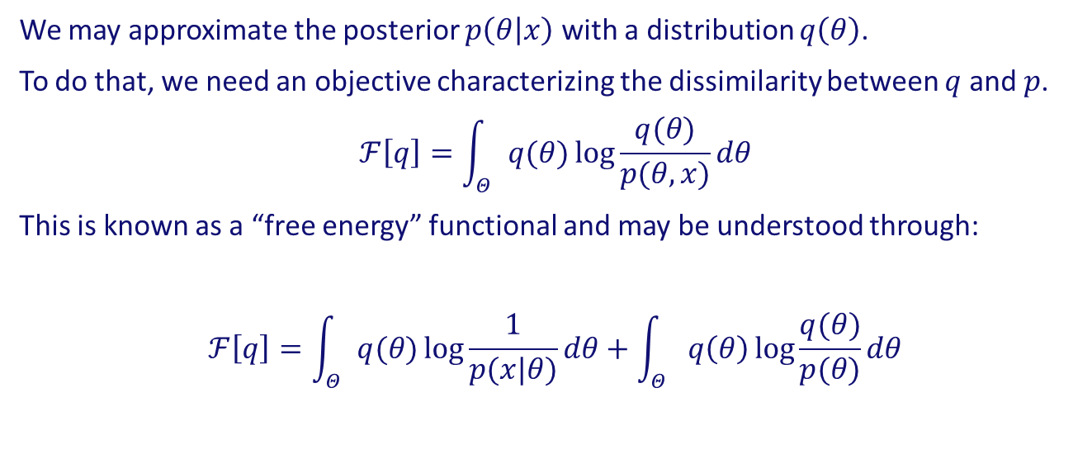
Approximate inference
We may approximate the posterior $p\left(θ | x\right)$ with a distribution $q\left(θ\right)$.
To do that, we need an objective characterizing the dissimilarity between $q$ and $p$.
$$ℱ\left[q\right]=\int_{Θ}{q(θ)}\log{\frac{q(θ)}{p(θ,x)}}dθ$$
This is known as a “free energy” functional and may be understood through:
$$ℱ\left[q\right]=\int_{Θ}{q(θ)}\log{\frac{1}{p(x|θ)}}dθ+\int_{Θ}{q\left(θ\right)\log{\frac{q(θ)}{p(θ)}}}dθ$$
prediction error
complexity
Notes:
If an approximate posterior suffices, then we can expand the model class.
Audience may be familiar with (Markov Chain) Monte Carlo.
I’ve used a simpler model, ie p(x,theta), instead of the NARX model to keep the equations readable.
Accuracy = expected log-likelihood under current approximate posterior q.
Complexity = change in belief required to produce level of accuracy.
Audience may recognize regularized risk minimization.

Slide 17
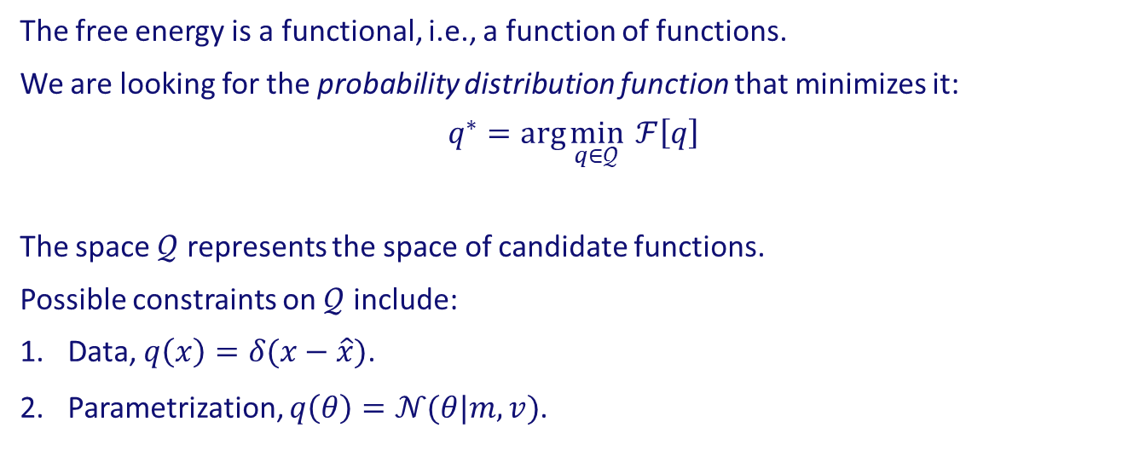
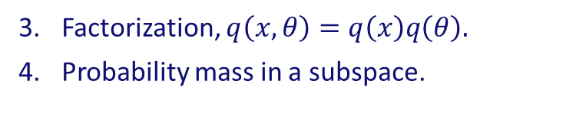
Minimizing free energy
The free energy is a functional, i.e., a function of functions.
We are looking for the probability distribution function that minimizes it:
$$q^{∗}=\arg{\min_{q∈𝒬}{ ℱ\left[q\right]}}$$
The space $𝒬$ represents the space of candidate functions.
Possible constraints on $𝒬$ include:
Data, $q\left(x\right)=δ(x−\hat{x})$.
Parametrization, $q\left(θ\right)=𝒩(θ|m,v)$.
Factorization, $q\left(x,θ\right)=q\left(x\right)q\left(θ\right).$
Probability mass in a subspace.
Van de Laar (2021). Chance-constrained active inference.
Notes:
Constraints: data, marginalization, factorization, parametric family, etc.
These constraints can be incorporated by forming a Lagrangian.

Slide 18
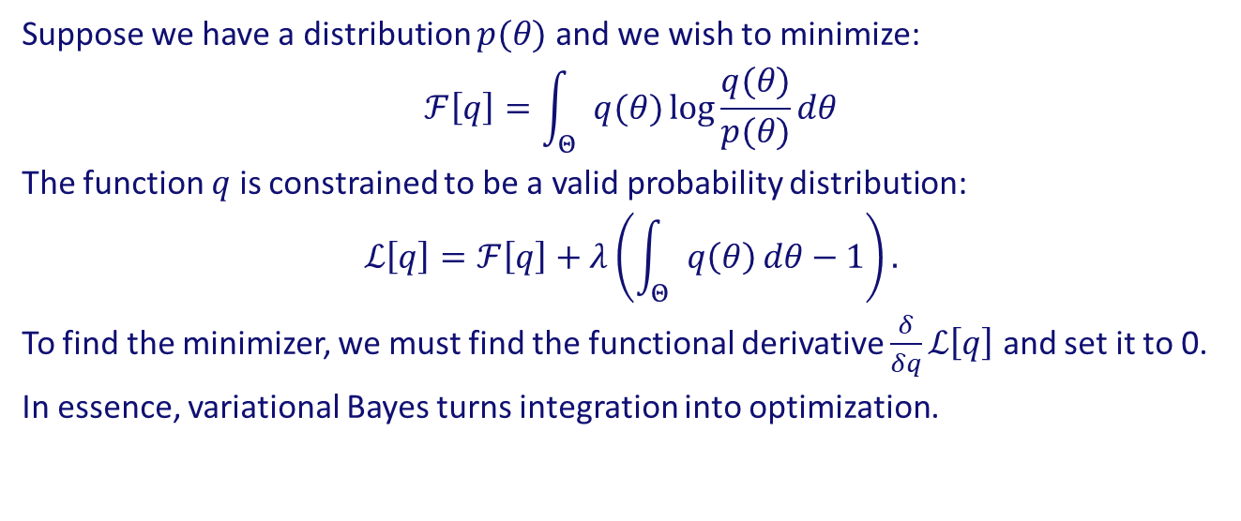
Minimizing free energy
Suppose we have a distribution $p(θ)$ and we wish to minimize:
$$ℱ\left[q\right]=\int_{Θ}{q(θ)}\log{\frac{q(θ)}{p(θ)}}dθ$$
The function $q$ is constrained to be a valid probability distribution:
$$ℒ\left[q\right]=ℱ\left[q\right]+λ\left(\int_{Θ}{q\left(θ\right)}dθ−1\right).$$
To find the minimizer, we must find the functional derivative $\frac{δ}{δq}ℒ\left[q\right]$ and set it to 0.
In essence, variational Bayes turns integration into optimization.
Notes:
Simplest possible example.
Frechet derivative must exist.

Slide 19
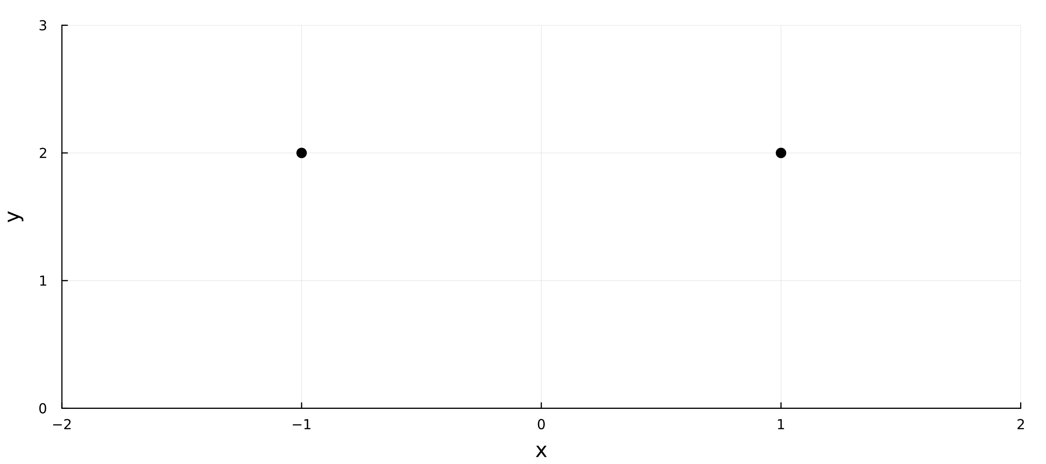
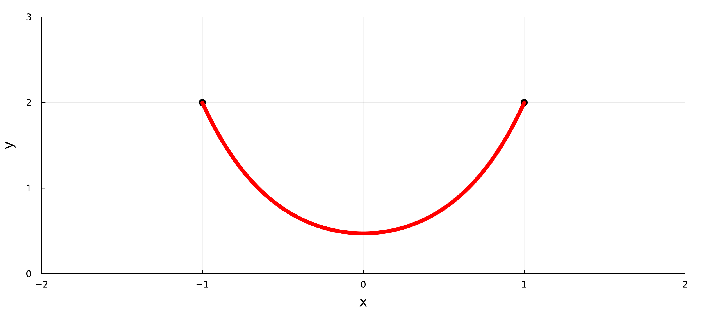
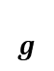
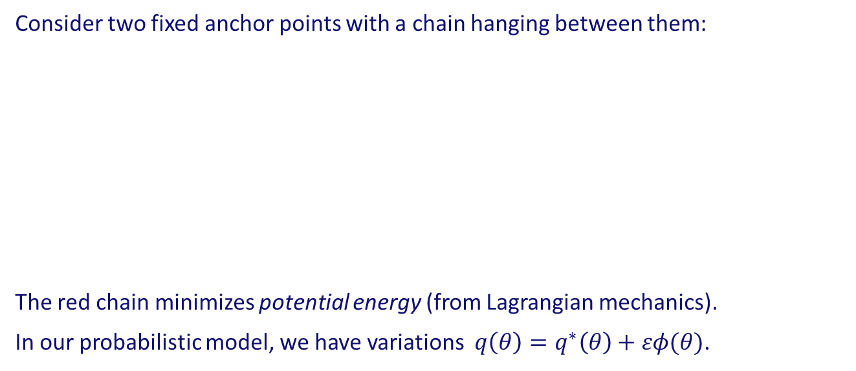
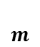
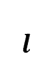
Variations on a curve
Consider two fixed anchor points with a chain hanging between them:
The red chain minimizes potential energy (from Lagrangian mechanics).
In our probabilistic model, we have variations $q\left(θ\right)=q^{∗}\left(θ\right)+εφ(θ)$.
$$l$$
$$m$$
“variations”
$$g$$
Notes:
Chain’s length is fixed, it has mass, it’s anchored at two points and gravity is pulling on it.
Ask whether blue line seems like it is the optimal solution given that gravity is pulling on the chain.
Ask whether purple line is best?
Only 1 curve of the hanging chain minimizes potential energy.
Note: the formula for the chain is y(x) = c1 / mg cosh(mg/c1 (x + c2)) – lambda / c1, where c1 and c2 are boundary conditions (based on positions of anchor points) and lambda is a constraint for the chain length.

Slide 20
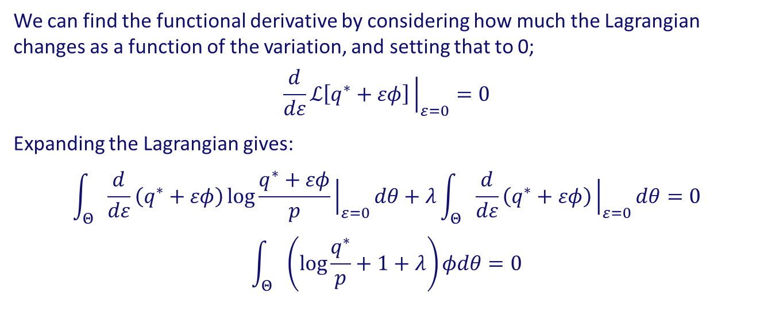
Minimizing free energy
We can find the functional derivative by considering how much the Lagrangian changes as a function of the variation, and setting that to 0;
$$\frac{d}{dε}ℒ\left[q^{∗}+εφ\right]{\left.​\right|}_{ε=0}=0$$
Expanding the Lagrangian gives:
$$\int_{Θ}{\frac{d}{dε}}\left(q^{∗}+εφ\right)\log{\frac{q^{∗}+εφ}{p}}{\left.​\right|}_{ε=0}dθ+λ\int_{Θ}{\frac{d}{dε}}\left(q^{∗}+εφ\right){\left.​\right|}_{ε=0}dθ=0$$
$$\int_{Θ}{\left(\log{\frac{q^{∗}}{p}}+1+λ\right)}φdθ=0$$
Senöz, van de Laar, Bagaev & de Vries (2021). Variational Message Passing and Local Constraint Manipulation in Factor Graphs.
Notes:
Plug q = q* + e \eta into lagrangian.

Slide 21
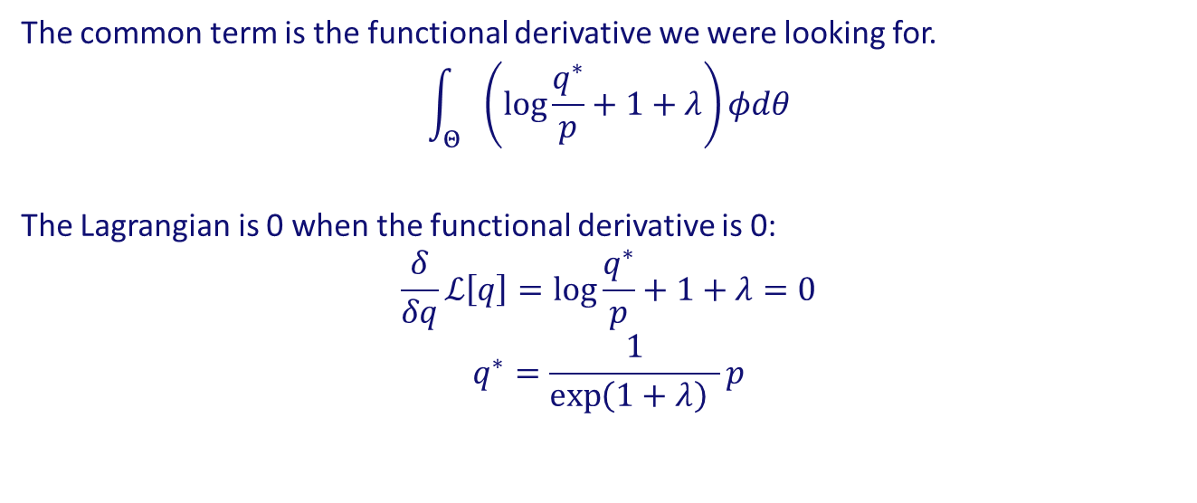
Minimizing free energy
The common term is the functional derivative we were looking for.
$$\int_{Θ}{\left(\log{\frac{q^{∗}}{p}}+1+λ\right)}φdθ$$
The Lagrangian is 0 when the functional derivative is 0:
$$\frac{δ}{δq}ℒ\left[q\right]=\log{\frac{q^{∗}}{p}}+1+λ=0$$
$$q^{∗}=\frac{1}{\exp\left(1+λ\right) }p$$
Senöz, van de Laar, Bagaev & de Vries (2021). Variational Message Passing and Local Constraint Manipulation in Factor Graphs.
Notes:
Fundamental lemma of variational calculus.

Slide 22

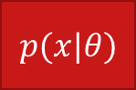
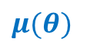
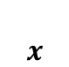
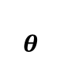
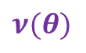
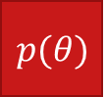
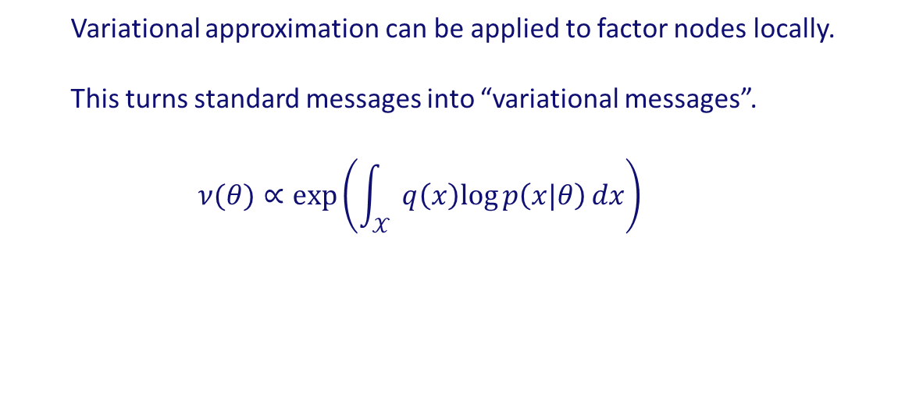
Variational message passing
One can distribute the free energy functional over a factor graph.
$$p(θ)$$
Variational approximation can be applied to factor nodes locally.
This turns standard messages into “variational messages”.
$$ν(θ)∝\exp\left(\int_{𝒳}{q\left(x\right)log{p\left(x|θ\right)}dx}\right)$$
$$μ(θ)$$
$$θ$$
$$μ(θ)$$
$$ν(θ)$$
$$p(x|θ)$$
$$x$$
Dauwels (2007). On variational message passing on factor graphs.
Notes:
Variational approximation of messages is called variational message passing.
Bethe free energy

Slide 23
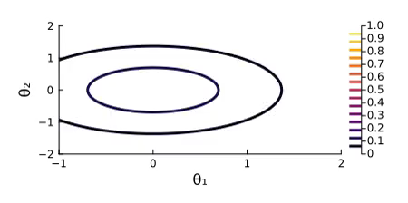

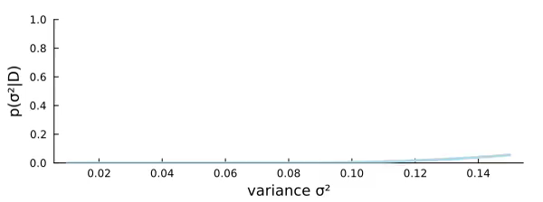
Model 2
Notes:
- Posteriors concentrate on regions as more data streams in.

Slide 24
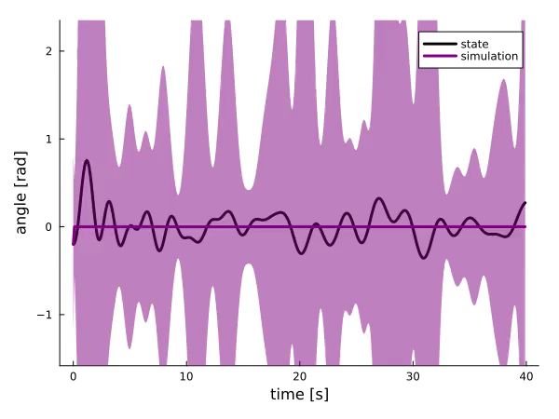
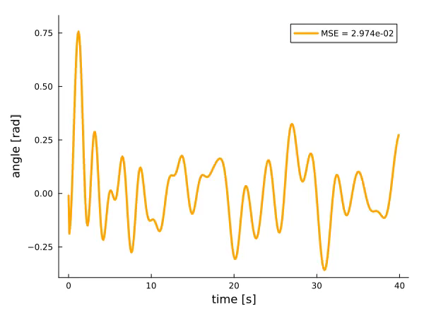
Model 2
Notes:
- Left simulation, right simulation error.

Slide 25
Take-aways
Quantified uncertainty should be part of models.
Variational Bayes turns integration into optimization.
Variational message passing is inference distributed over a factor graph.

Slide 26



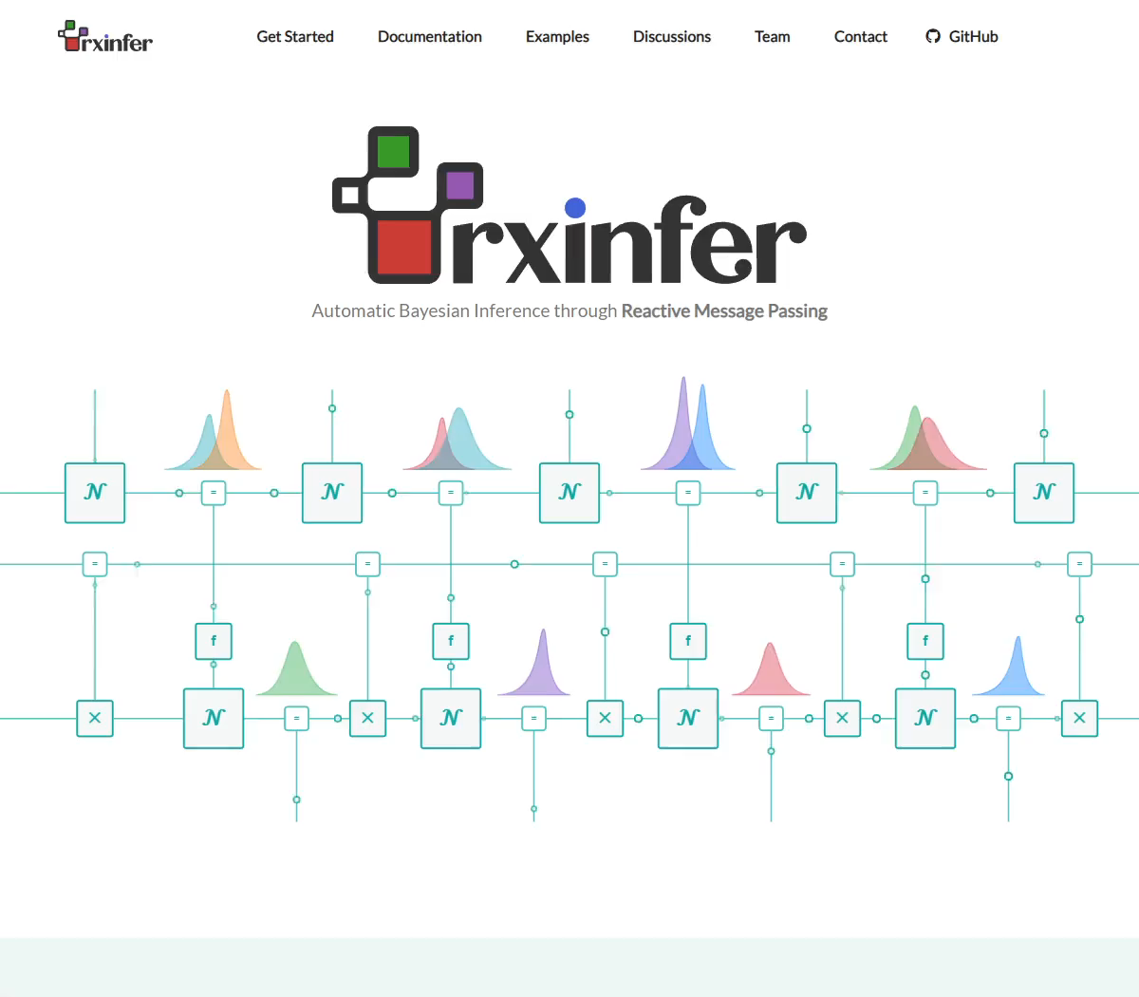
Checkout:
https://github.com/biaslab/RxInfer.jl

Slide 28
Weakly informative priors
A common critique is that the act of “choosing priors” leads to non-objective results.
-> One should rely on as generic and uninformative priors as possible.
In the case of polynomial NARX models, I argue that one may use “weak information” in the sense that lower-order terms are more likely to have large coefficients than higher-order terms.
This may be incorporated by having a zero-mean Gaussian prior with large variances for low-order terms (indicating uncertainty) and small variances for high-order terms (i.e., you are certain that the coefficient is close to 0).

Slide 29


Alternative free energy decomposition
The “free energy” objective decomposes into prediction error and complexity:
$$ℱ\left[q\right]=\int_{Θ}{q(θ)}\log{\frac{1}{p(x|θ)}}dθ+\int_{Θ}{q\left(θ\right)\log{\frac{q(θ)}{p(θ)}}}dθ$$
It can also be decomposed as an upper bound to negative model evidence:
$$ℱ\left[q\right]=\int_{Θ}{q(θ)}\log{\frac{q(θ)}{p(θ|x)}}dθ−\log{p(x)}$$
In this sense, a smaller free energy means 1) a better approximation of the posterior and/or 2) a better model for the given data.
model evidence
approximation to posterior ($≥0$)

Slide 30

Normalization
The solution for $q^{∗}$ led to a mysterious 1 / exp term. Where does that come from?
It comes from the normalization constraint imposed on the Lagrangian.
If we plug the optimal form into the constraint function, we get:
$$\int{\frac{1}{\exp\left(1+λ\right)}p\left(θ\right)dθ −1}=0$$
Solving for $λ$ gives:
$$λ=\log{\int{p\left(θ\right)dθ}}−1$$

Slide 31


Mean-field
If there are multiple unknowns in the model, then you may choose to factorize $q$:
$$q\left(θ,σ^{2}\right) :=q\left(θ\right)q\left(σ^{2}\right)$$
You would have multiple approximations, each dependent on the others.
-> Solutions must be iterated until convergence.
“Mean-field” is a common factorization choice, but may lead to poor performance.
“Structured” factorizations are richer, but require more manual derivation work.
Notes:
Structured factorizations.
Variational inference is iterative in nature.

Slide 32

Limitations
Common parametric distributions are not closed under nonlinear transformations.
A squared Gaussian distributed random variable is not Gaussian distributed.
Typical simplifications of $q$ are based on (in)dependence between variables.
This may cause under-estimation of variance.
Not much is known about the stability of variational Bayesian estimators and some appear to be (at least numerically) unstable in practice.
Notes:
- One can work with log-pdf’s, but that becomes more complex after every nonlinear operation.

